Slide 1




ASEAN SDG Indicators
Baseline Report 2020
Singapore Department of Statistics
Hsiu Chin TANG
Chair of ASEAN Working Group on Sustainable Development Goals Indicators
(WGSDGI)
23 October 2020

Slide 2
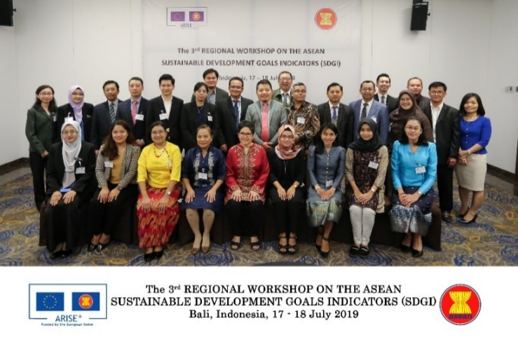
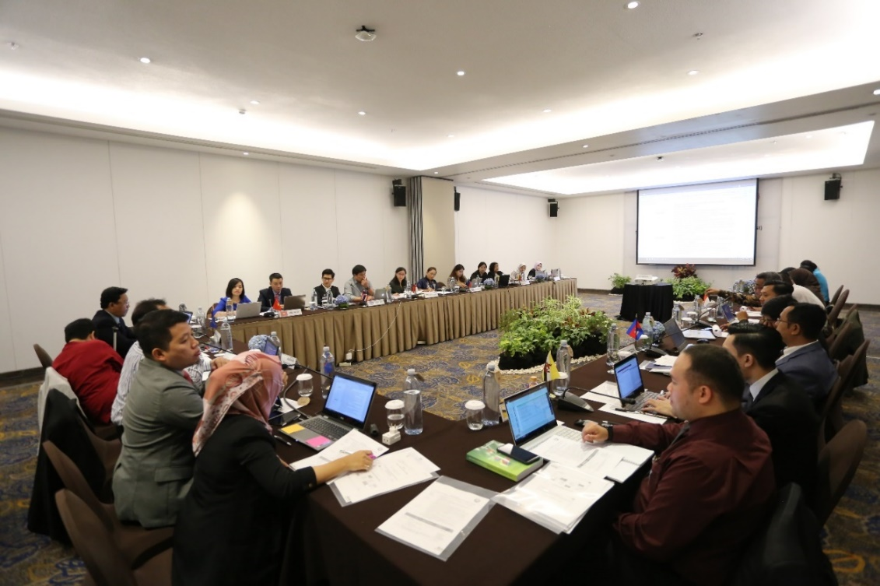
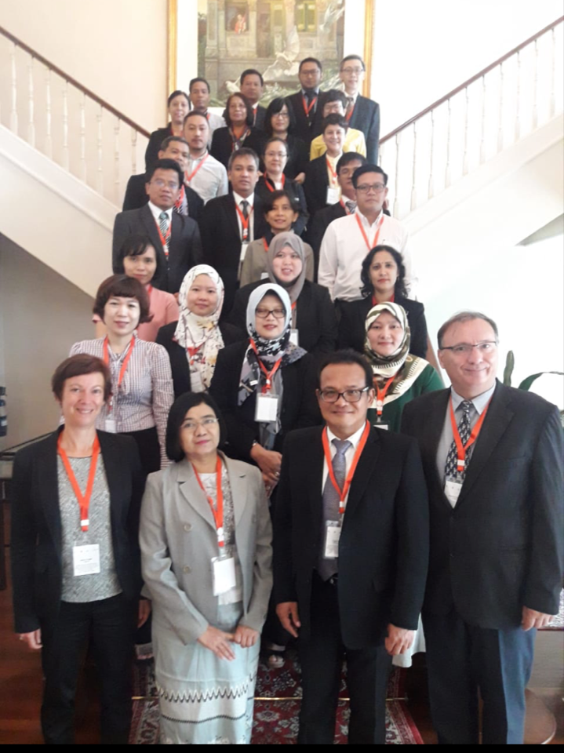
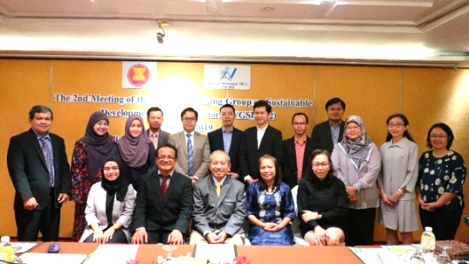
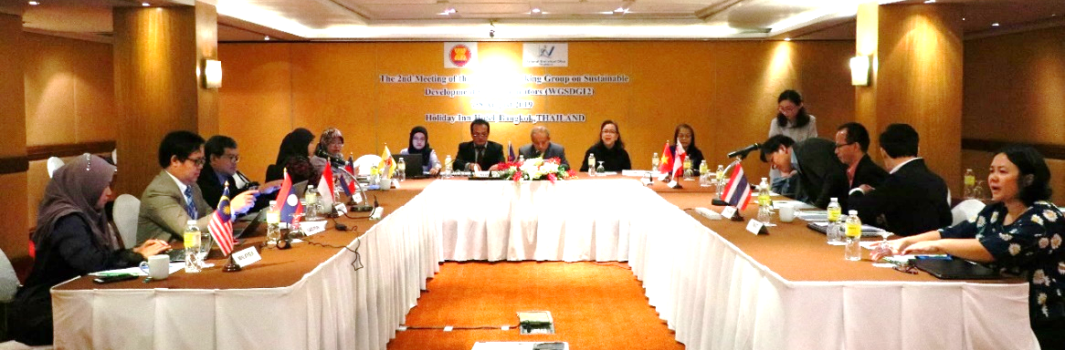
Introduction
The 2nd Regional Workshop of ASI-CT on Social and SDG Indicators 2018
WGSDGI Meeting 2019

Slide 3
Introduction
2017 – WGSDGI was set up; reviewed SDG indicators with National Statistical Offices (NSOs) and relevant institutions within the National Statistical Systems (NSSs) in the AMS
  Identified a preliminary set of 143 SDG indicators
  Further revised to a list of 63 SDG main indicators along with sub-indicators, forming a total set of 134 indicators in consideration of data availability in AMS
May 2020 – Conducted a quality assessment of AMS’ metadata for the 134 indicators in relation to Global SDG Metadata, based on the following dimensions:
  (1) Relevance
  (2) Consistency checks in terms of (i) concepts and definitions, (ii) methods, (iii) coverage and (iv) timeliness or frequency of data
  (3) Credibility in terms of data source
  (4) Completeness of country entries or the no. of countries that are able to provide the data
Trimmed down to 67 indicators for inclusion in Baseline report

Slide 4
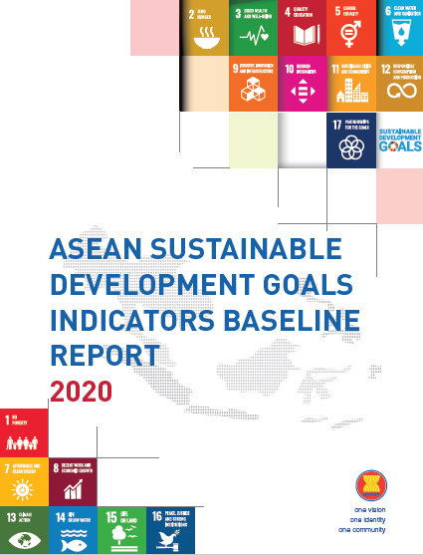
Introduction
Oct 2020 – Launch
Inaugural ASEAN SDG Indicators Baseline Report 2020 covering
67 indicators
  Establish baseline info of SDGs being tracked and measured
  in ASEAN for 2016-2018
  Aid future monitoring of progress in achieving 2030 Agenda
  and to support relevant policymaking at both national and
  regional levels
Online Database covering 134 indicators
Static table – highlights the data for 2016 and latest year available
User-defined tables – users can create their own tables from the database

Slide 5


ASEAN SDG Indicators
~ Key Findings ~

Slide 6

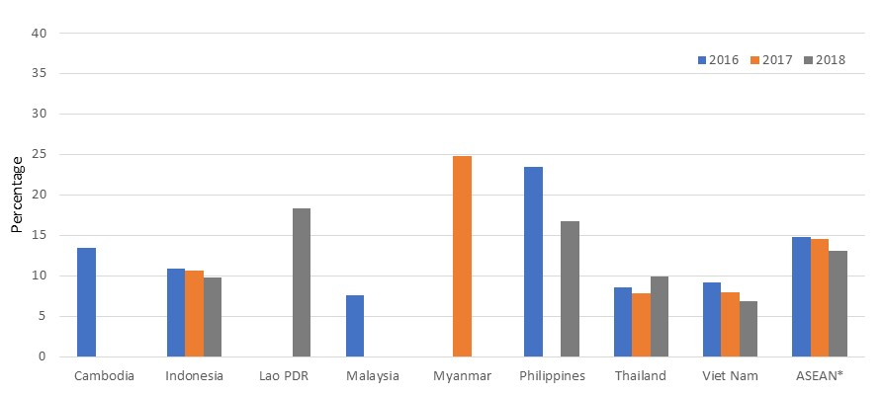
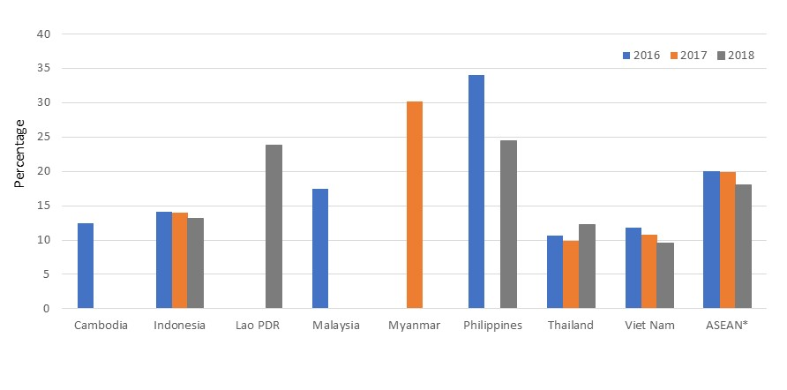
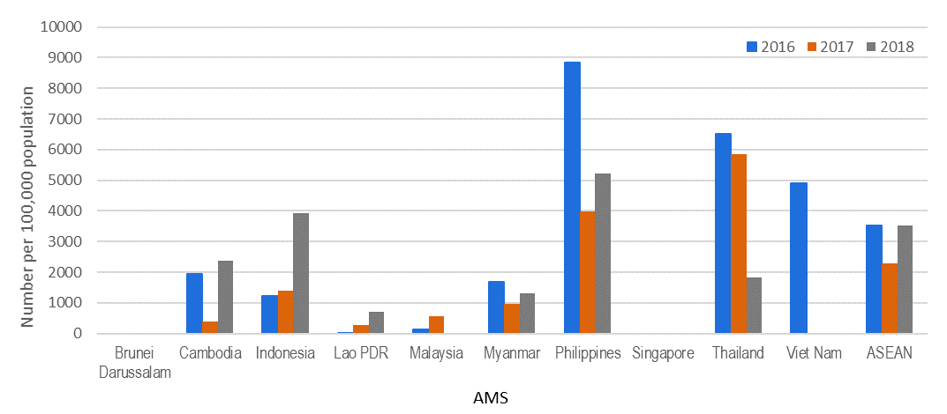
End poverty in all its forms everywhere
Rural poverty generally higher than national poverty
Living below national poverty line
Living below rural poverty line
Among AMS with national poverty lines, an average of 13.0% of total population were living below the countries’ poverty lines in 2018, while rural poverty rate was higher with 18.0% of rural people living below the poverty line
Large variations in climate-related disaster losses due to randomness of extreme natural events
Losses attributed to climate-related disasters
Losses in terms of lives, missing persons and directly affected persons attributed to climate-related disasters varied in the region, with some AMS more frequently affected than others

Slide 7

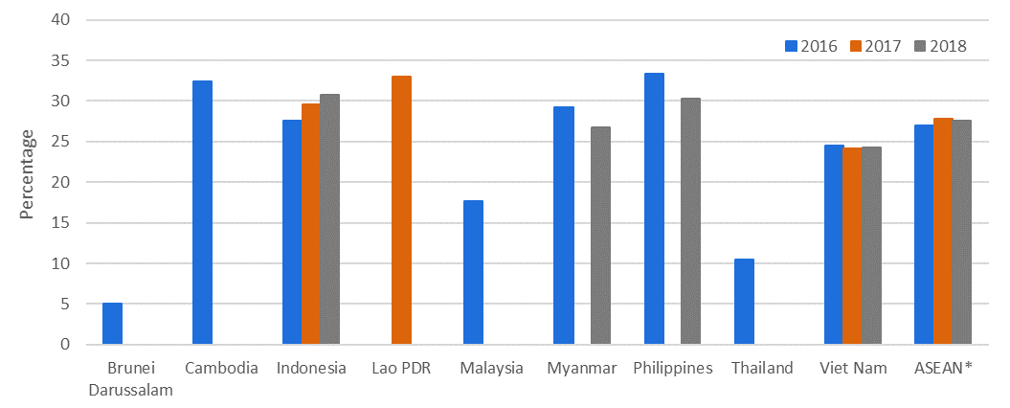
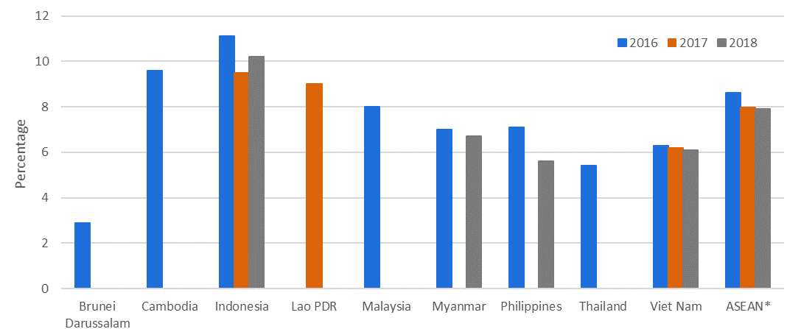
End hunger, achieve food security and improved nutrition and promote sustainable agriculture
Stunting among children under 5 years of age
(height-for-age < -2 standard deviation from median of WHO Child Growth Standards)
Prevalence of stunting and wasting varied across AMS
Prevalence of stunting and wasting varied across AMS, with an average of 27.0% of children under 5 years of age experiencing stunting, and an average of 8.6% of children experiencing wasting in ASEAN in 2016
Malnutrition – wasting among children under 5 years of age
(weight-for-height < -2 standard deviation from median of WHO Child Growth Standards

Slide 8

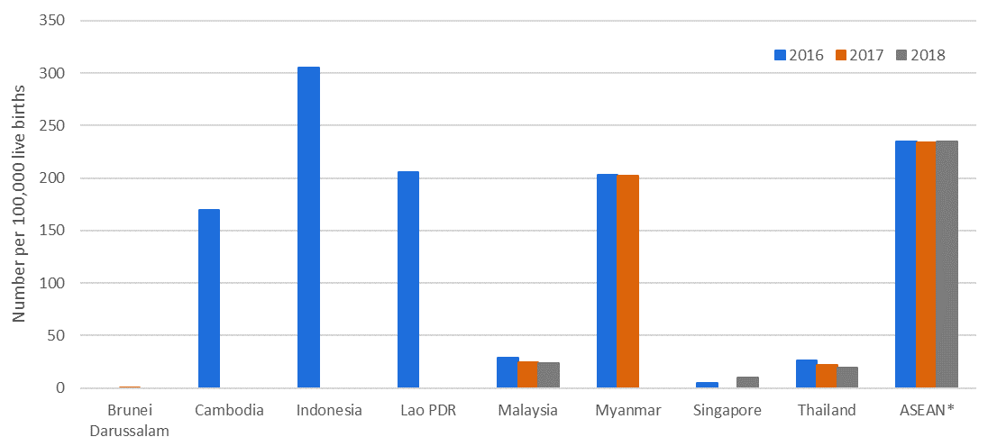
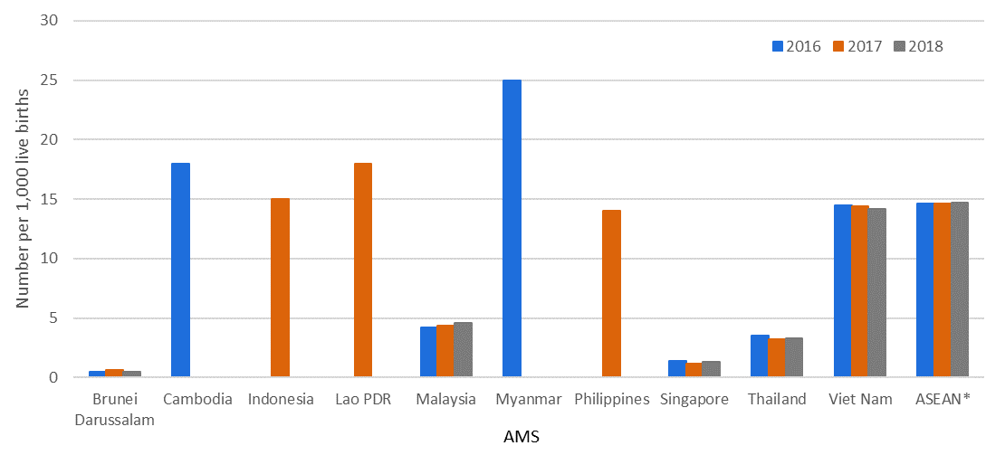
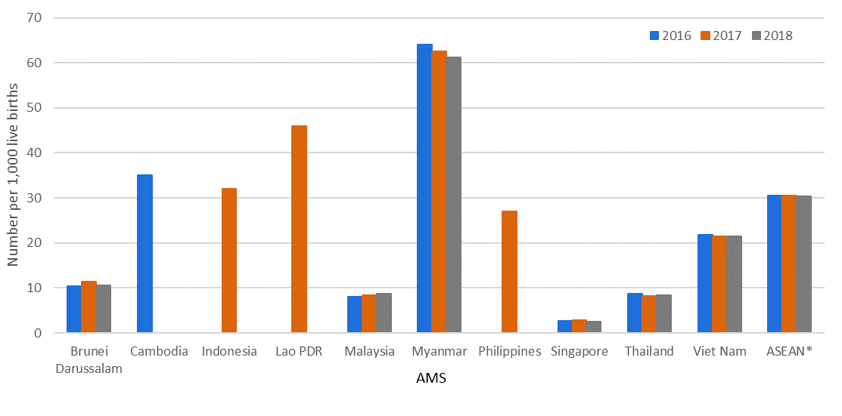
Ensure healthy lives and well-being for all at all ages
Maternal mortality, neonatal mortality and under-5 mortality rates were relatively high in some AMS
There were 235 maternal deaths per 100,000 live births in 2016, while neonatal mortality rate averaged about 15 neonatal deaths per 1,000 live births in 2018, and the under-five mortality rate averaged about 30 out of 1,000 children born alive
Maternal mortality ratio
Neonatal mortality rate
Under-five mortality rate
Neonatal mortality rate
Under-five mortality rate

Slide 9
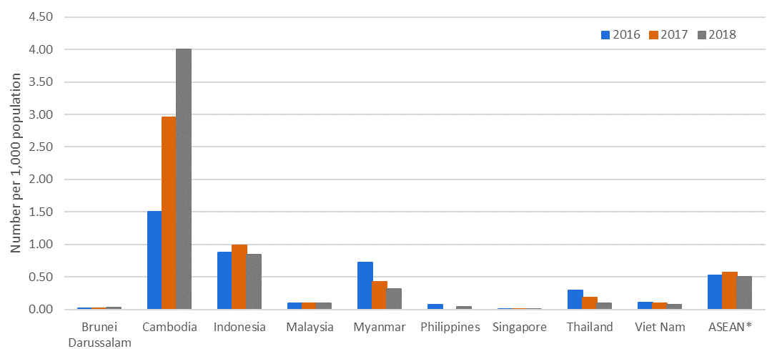
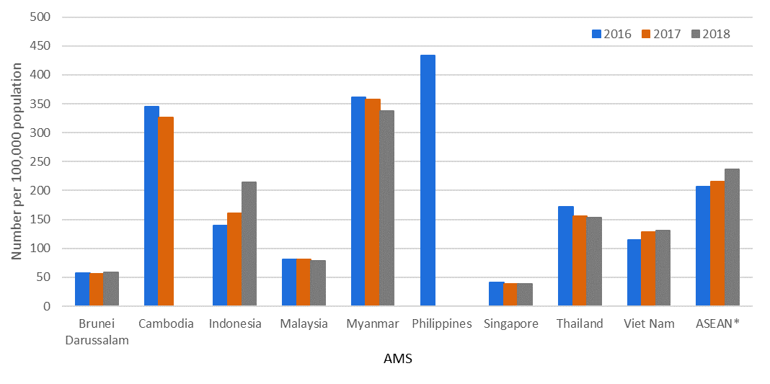
Ensure healthy lives and well-being for all at all ages
Low malaria incidence rate
Malaria incidence
Incidence of malaria was generally low in the region, at about 0.5 per 1,000 population on average during 2016-2018
Tuberculosis incidence rate high in some AMS
Tuberculosis incidence
Incidence rate of tuberculosis in the region averaged 236 cases per 100,000 population in 2018

Slide 10

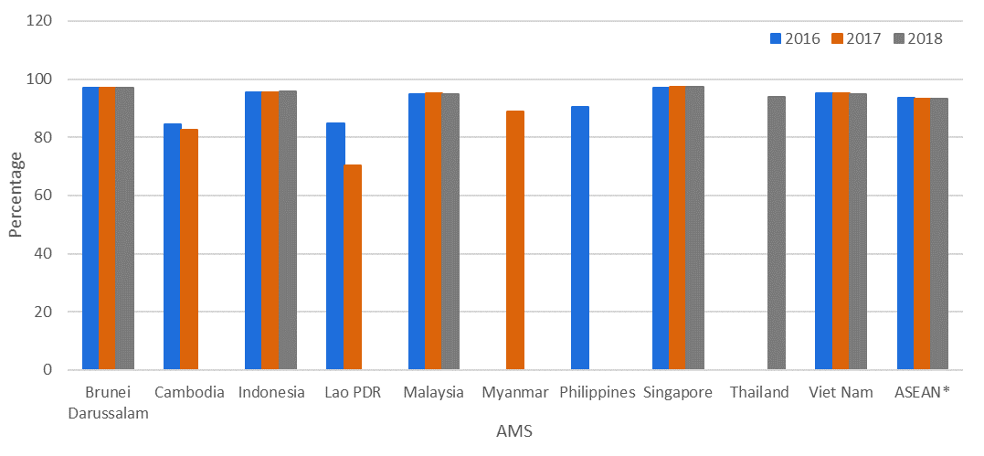
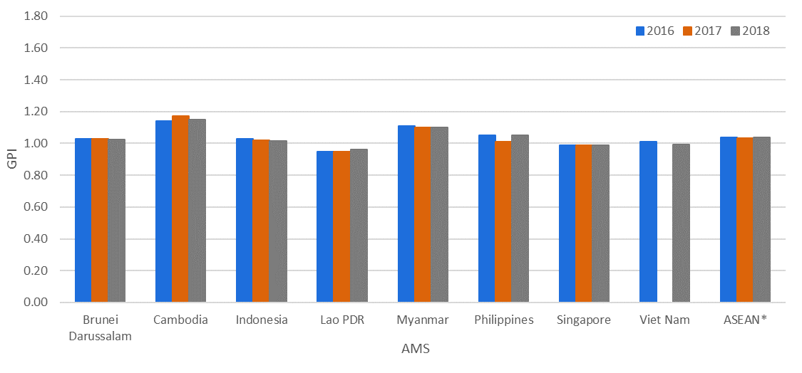
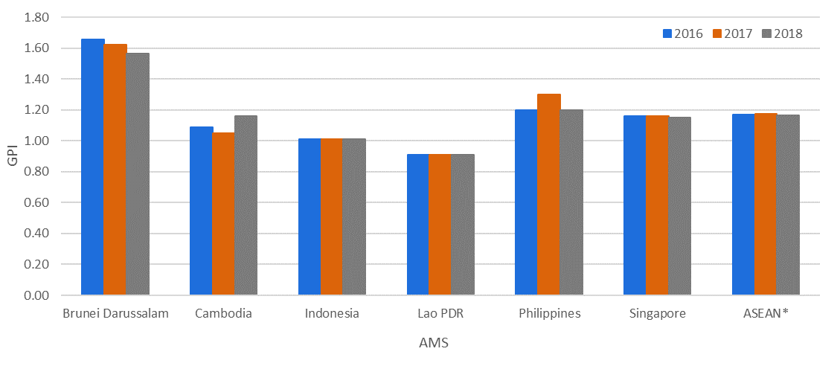
Ensure inclusive and equitable quality education and promote lifelong learning opportunities for all
High literacy among adult population
Basic functional literacy
90%
Literacy rates for both sexes in ASEAN reached 93.4% in 2018 (males 94.8%, females 91.9%), with 7 out of 10 countries having literacy rates above 90%
Equitable access to primary and secondary education for children
ASEAN reached near gender parity in gross enrolment ratio in primary and secondary education in 2018, with minimal or no inequality in majority of AMS. Proportionately more females compared to males enrolled in tertiary education.
Gender Parity Index (GPI) Gross Enrolment Ratio
Secondary
Tertiary
GPI = 1 (equal parity)

Slide 11
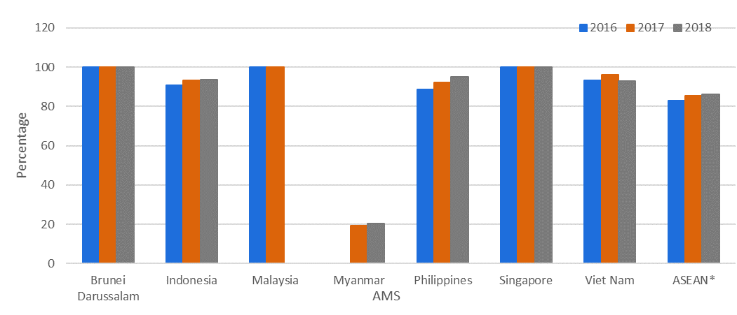
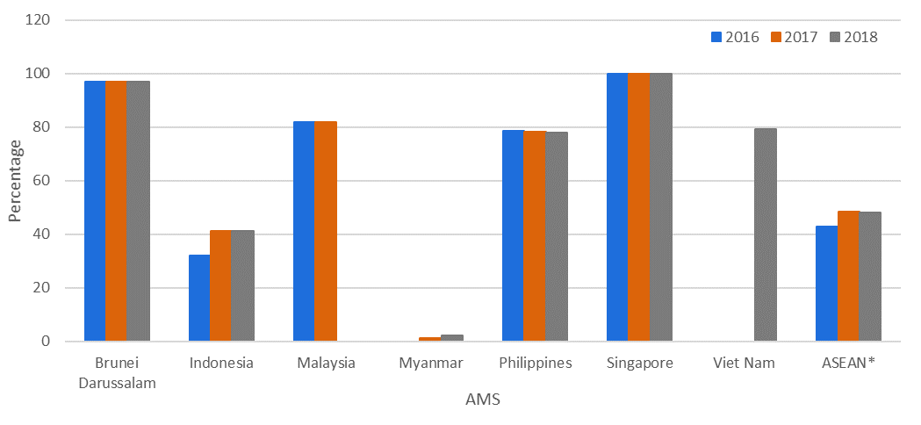
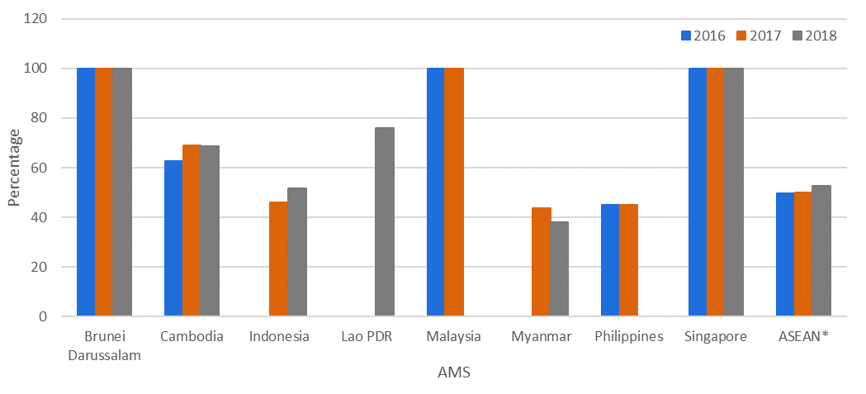
Ensure inclusive and equitable quality education and promote lifelong learning opportunities for all
Children generally has access to basic services/facilities in primary schools …
Primary schools with electricity
Basic facilities/services provided by
primary schools in 2018:
electricity – 86.1%
computers for pedagogical purposes
– 48.2%
single-sex basic sanitation facilities – 52.7 %
Primary schools with computer for pedagogical purposes
Primary schools with single-sex basic sanitation facilities

Slide 12
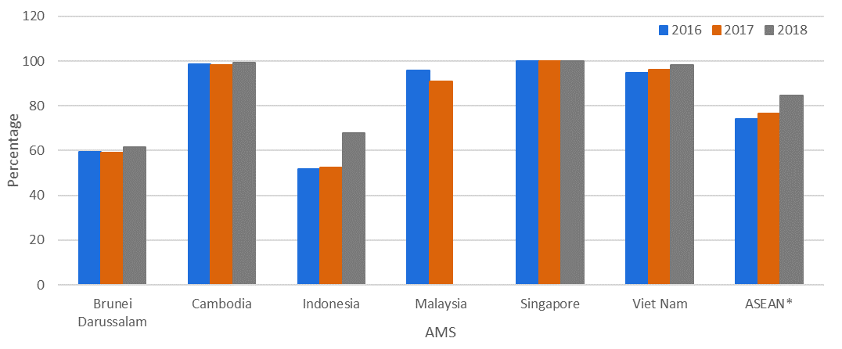
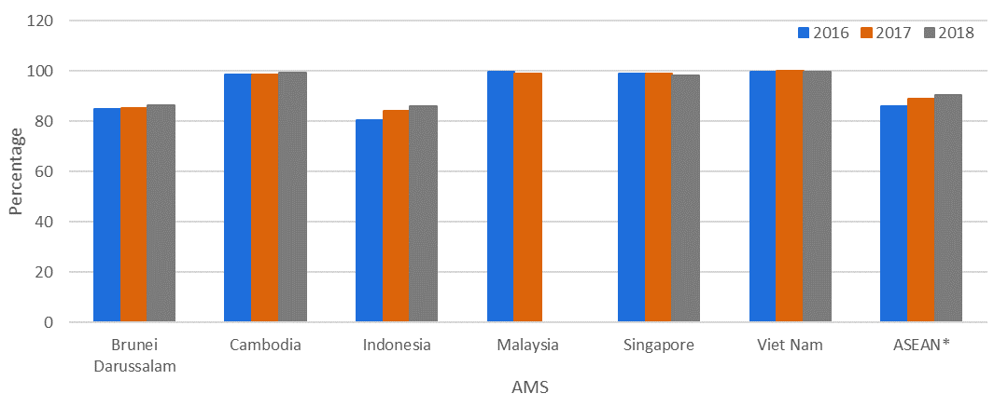
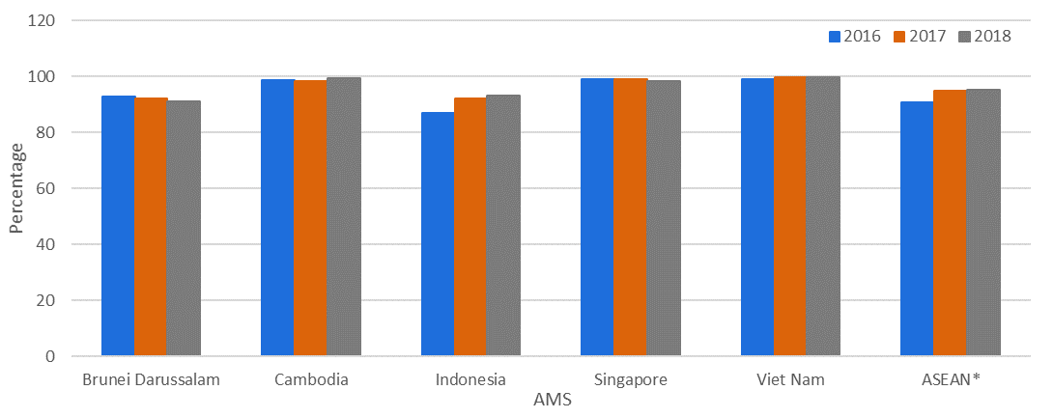
Ensure inclusive and equitable quality education and promote lifelong learning opportunities for all
… as well as qualified teachers in pre-primary to lower secondary schools
Teachers with minimum required qualifications
Proportion of teachers with the minimum qualifications:
pre-primary – 84.5%
primary – 90.3%
lower secondary – 95.3%
Pre-primary
Primary
Lower secondary

Slide 13

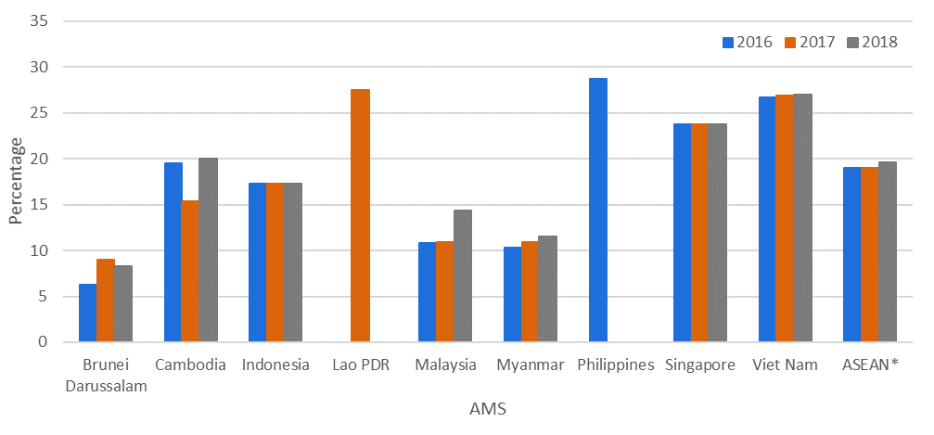
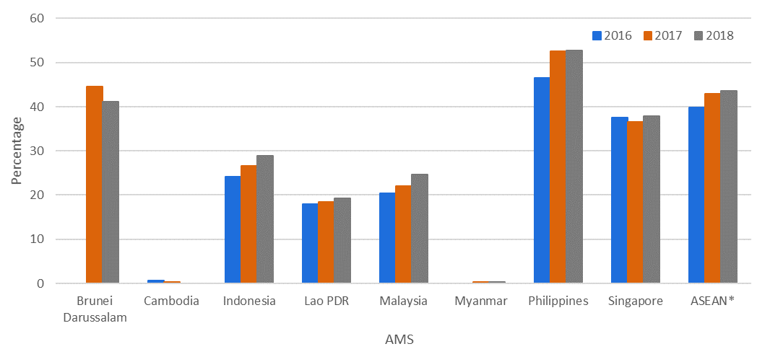
Achieve gender equality and empower all women and girls
Women holding key decision-making positions
In 2018, the share of women in:
national parliaments – 19.6%
managerial positions – 43.6%
Women in national parliaments
Women in managerial positions

Slide 14

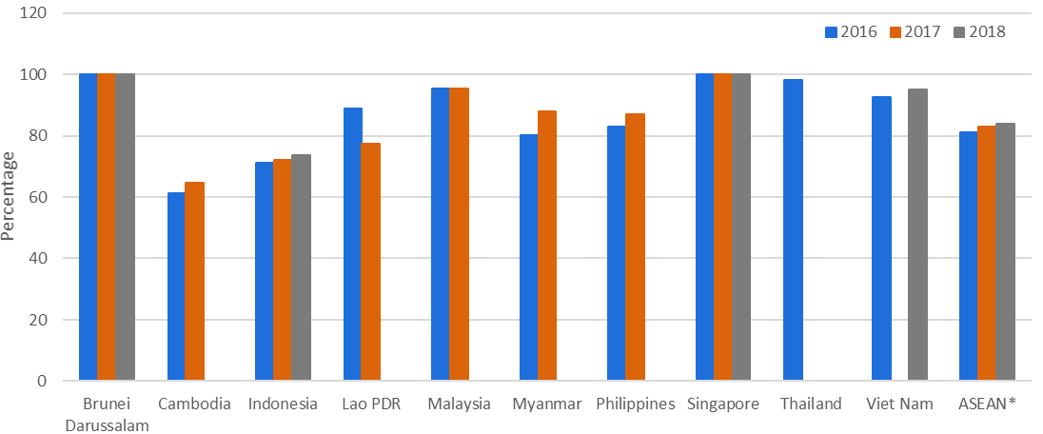
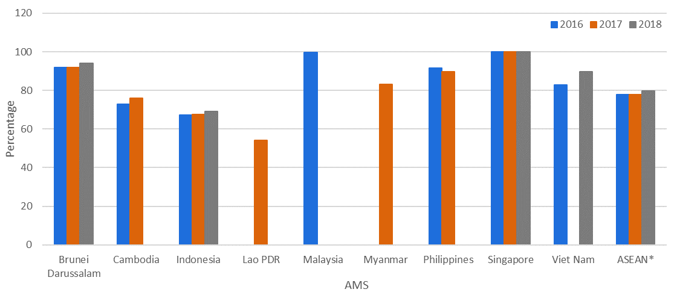
Ensure availability and sustainable management of water and sanitation for all
Most people in the region has access to improved drinking water and sanitation facilities
Safely managed drinking water services
Proportion of the region’s population having access to improved drinking water and sanitation facilities reached 83.8% and 79.7% respectively in 2018
Safely managed sanitation services

Slide 15

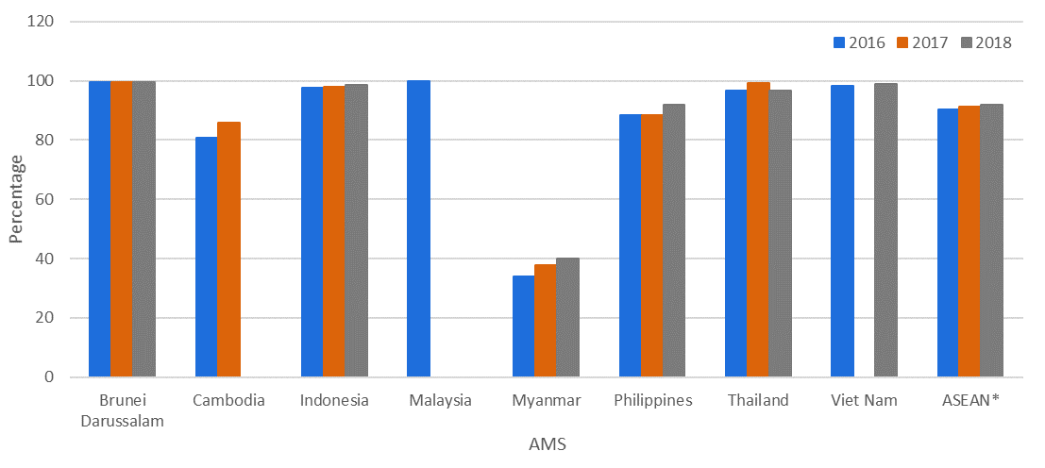
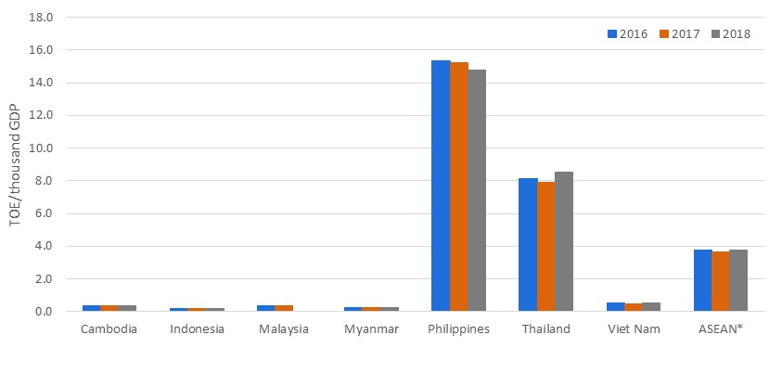
Ensure access to affordable, reliable, sustainable and modern energy for all
Majority has home access to electricity
Access to electricity
92.0% of people in ASEAN had access to electricity in their homes in 2018
Most AMS have low energy intensity levels
Energy intensity
Energy intensity in ASEAN averaged 3.8 Tonnes of Oil Equivalent (TOE) per unit output (in terms of thousand GDP in 2010 USD) in 2018

Slide 16

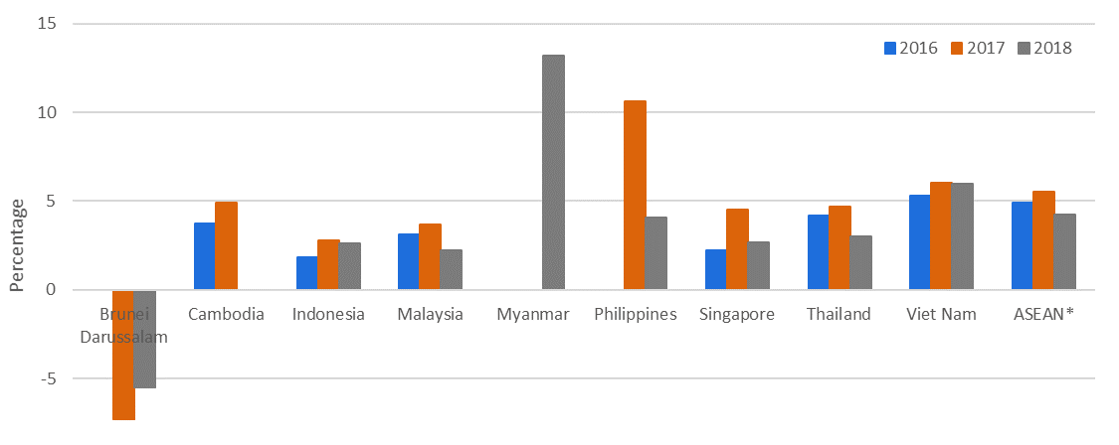
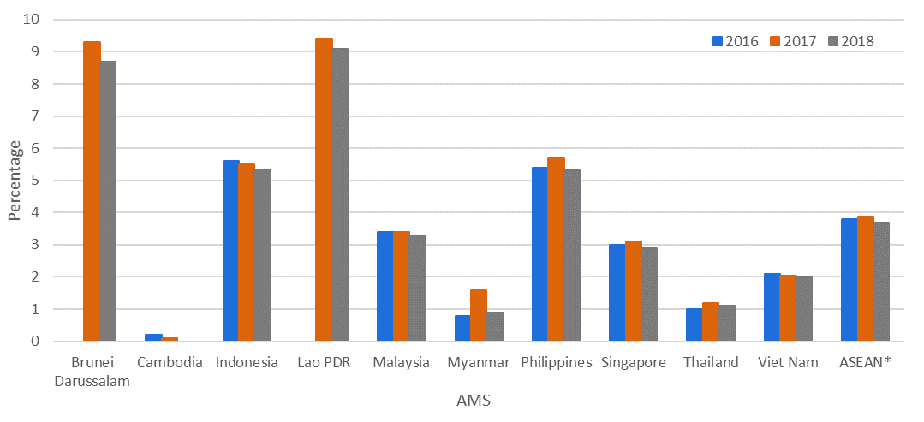
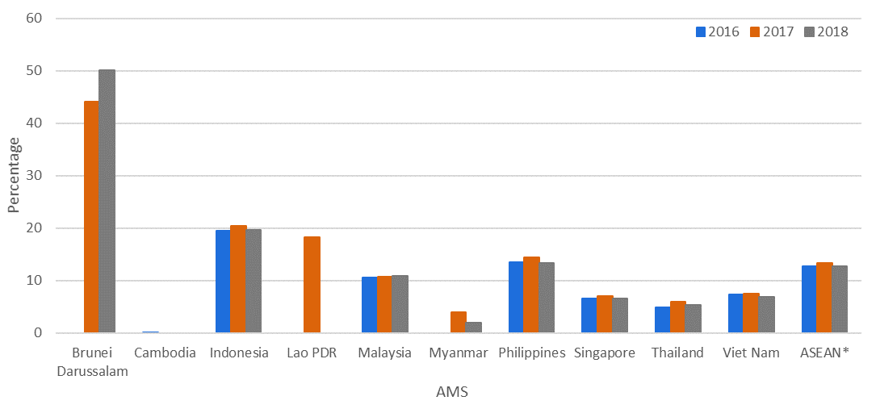
Promote sustained, inclusive and sustainable economic growth, full and productive employment and decent work for all
Real GDP growth per employed person
Most AMS saw improvement in labour productivity
Real GDP per employed person rose by 4.3% in 2018
Brunei Darussalam
High unemployment rates in some countries
Unemployment rate
Aged 15+
The ASEAN region recorded an average unemployment rate of 3.7% among persons aged 15+, with similar rates for males (4.0%) and females (3.7%) in 2018
Youth aged 15-24 unemployment rate averaged 12.7% in ASEAN in 2018
Aged 15-24 years

Slide 17

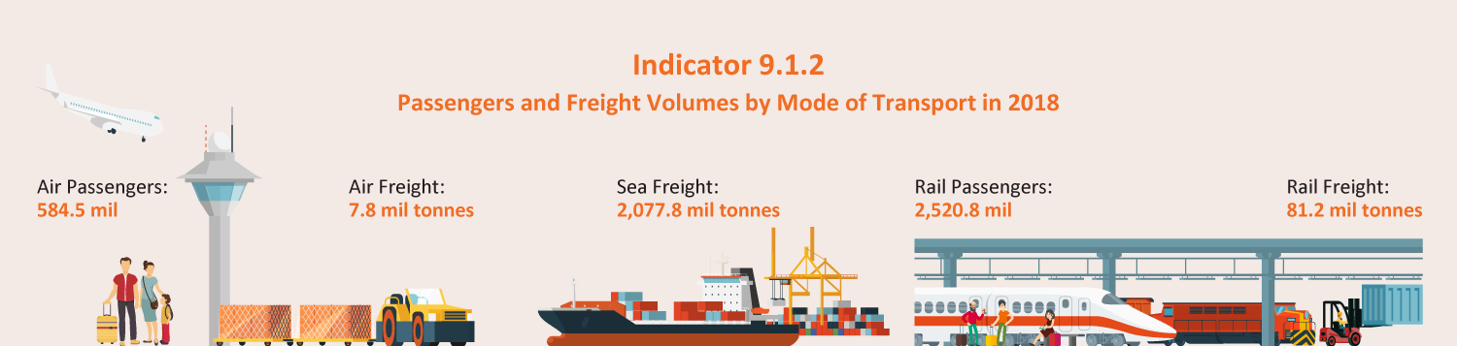
Build resilient infrastructure, promote inclusive and sustainable industrialisation and foster innovation
Region has well developed transport infrastructure in air, rail and sea
2018

Slide 18
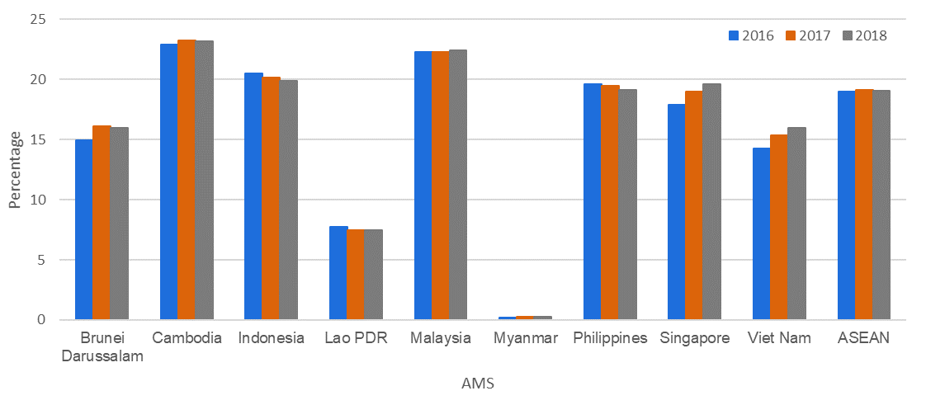
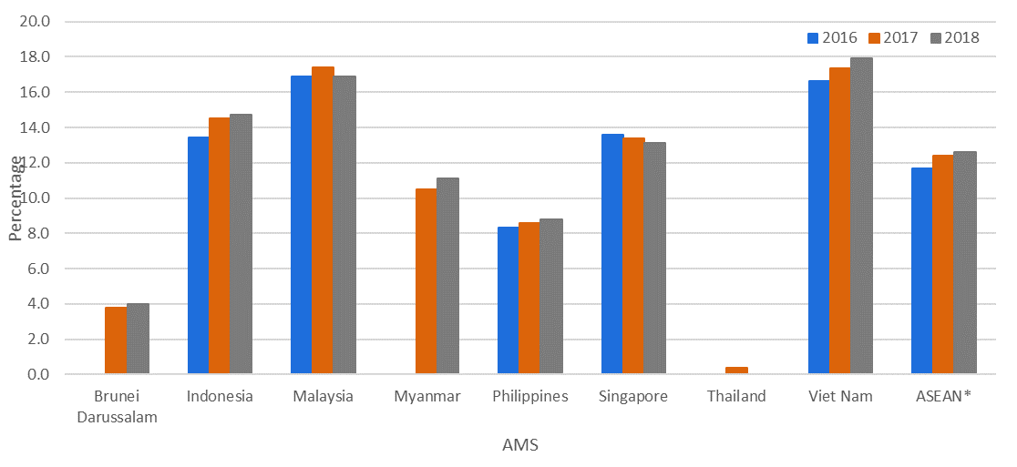
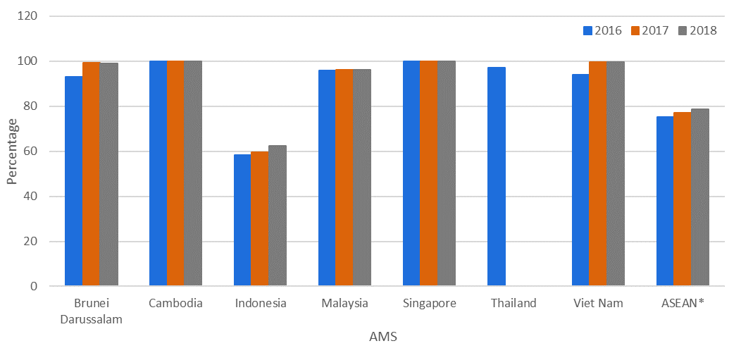
Build resilient infrastructure, promote inclusive and sustainable industrialisation and foster innovation
Manufacturing value added
Manufacturing is a key component of ASEAN economy
Share of manufacturing value added in real GDP in the region was 19.1%, while share of manufacturing employment in total employment was 12.6% in 2018
Manufacturing employment
High mobile-cellular coverage
Mobile network
In 2018, 78.6% of the region’s populations lived within the reach of a mobile-cellular signal

Slide 19

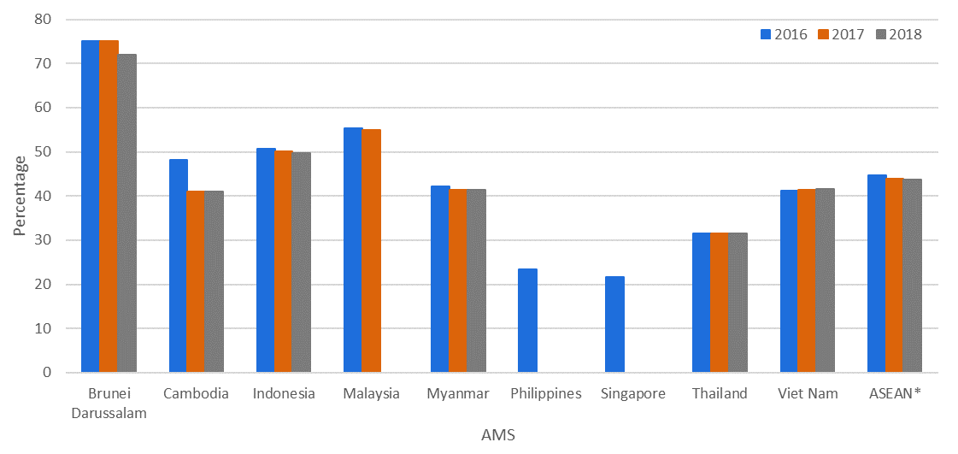
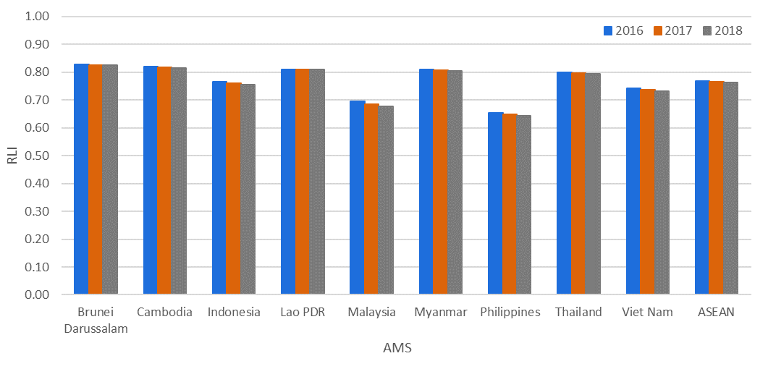
Protect, restore and promote sustainable use of terrestrial ecosystems, sustainably manage forests, combat desertification, and halt and reverse land degradation and halt biodiversity loss
Forest area
Little change in average proportion of natural forest area and risk level of species extinction
In 2018, natural forests made up 43.8% of total land area in ASEAN
Based on the Red List Index, the risk of species extinction for ASEAN was at a level of 0.76 in 2018
Red List Index

Slide 20

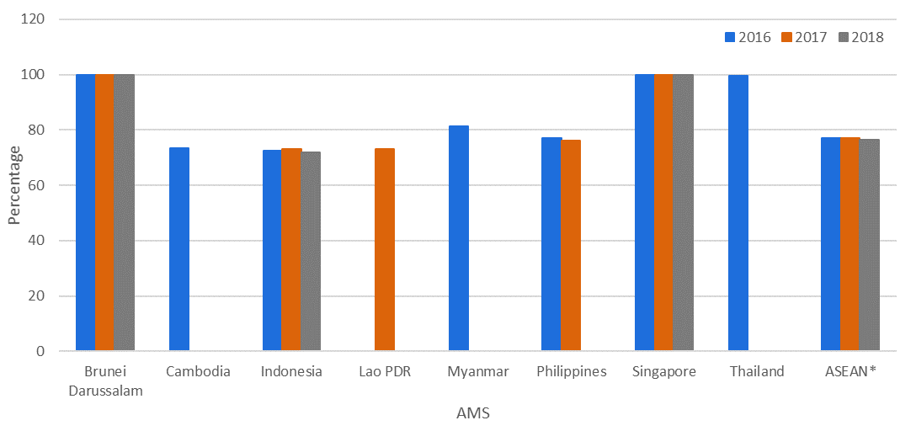
Promote peaceful and inclusive societies for sustainable development, provide access to justice for all and build effective, accountable and inclusive institutions at all levels
Children’s rights generally protected in ASEAN through civil registration
Children under age 5 with birth registration
Births of around 77 in 100 children under 5 years of age were officially registered with civil authorities in ASEAN during 2016-2018

Slide 21

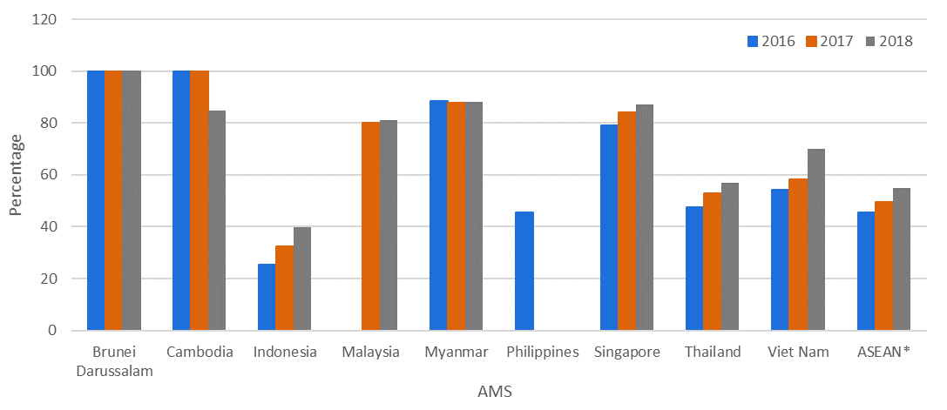
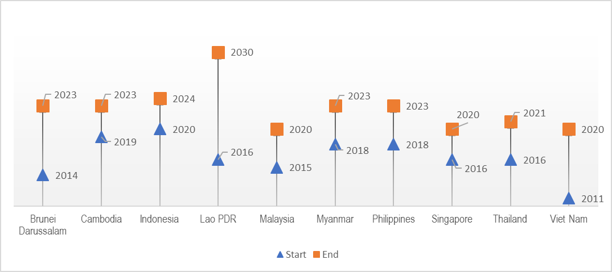
Strengthen the means of implementation and revitalise the Global Partnership for Sustainable Development
More than half of the region’s population has access to internet
Individuals using internet
In 2018, 55.1% of the people in the region were internet users
All AMS’ national statistical plans are under implementation
All AMS are implementing their national statistical plans. All had conducted at least one population and housing census in the last 10 years.
AMS’ latest national statistical plans (time span)

Slide 22
Way Forward

Slide 23
Institutional Mechanisms
AMS have established institutional mechanisms to coordinate plans, activities and responses for the production of SDG indicators to implement and monitor the 2030 Agenda
  Consist primarily of organisational structures and processes, supported by various coordinating mechanisms such as establishing focal points from relevant source agencies, and data exchange between NSOs and other source agencies
Mechanisms & Structures | Examples
Compilation of SDG Data | NSOs, Line Ministries Indonesia’s NSO is data producer for most SDG indicators Malaysia’s NSO is coordinator of SDG indicators development Myanmar’s NSO is the coordinator in producing SDG data
Coordination under Inter-Ministerial Committees or Specialised Working Groups | Brunei Darussalam’s Special Committee for National Coordination of the SDGs Cambodia’s Statistical Coordination Committee Singapore’s Inter-Ministry Committee on SDGs Thailand’s National SDG Secretariat Vietnam’s Statistical Working Group
Other Support Measures | Laos’ National SDG Secretariat technical meetings, advocacy activities, annual retreats Philippines’ Statistical Development Program, bi-annual meetings of SDGI Focal Points

Slide 24
Way Forward
NSSs and NSOs play a key role in reporting on national progress and serving as custodian agencies, supported by various institutional mechanisms and measures
There are significant challenges in sustaining monitoring systems given the vast data requirements of SDGs
There is a need for increased statistical capacities, including financing and human resources, in order to enhance engagement of multi-stakeholders for robust national monitoring systems
The ASEAN Community Statistical System (ACSS), through the WGSDGI, has been strengthening collaboration in the provision of data on SDG indicators in order to provide users with better and easier access to quality data
The ASEAN SDG Indicators Baseline Report and the Online Database for ASEAN SDG Indicators are ACSS’ efforts in providing relevant, timely and comparable statistics to support evidence-based policy making
ACSS is committed to enhance the capacity and strengthen national and regional cooperation to improve the availability and quality of data with the support of relevant agencies

Slide 25
Thank You

