Slide 1





SDG Online Database
ASEANStats Data Portals
By

Slide 2






Websites
ACSS and ASEANstats Resources
Websites
+
+
1. aseanstats.org
eBook, infographics, photos/videos, events, public docs
2. data.aseanstats.org
Data
3. wg.aseanstats.org
Private ACSS and WGs documents
4. dtt.aseanstats.org
For AMS to submit data to ASEANstats
eBooks
documents
Infographics
+
+
+
+
Events
data
Photos/Videos

Slide 3
The objectives of ASEANStats Websites
Center of resource
Dissemination
Promote Quality
To enhance the visibility of ASEAN regional statistical cooperation

Slide 4
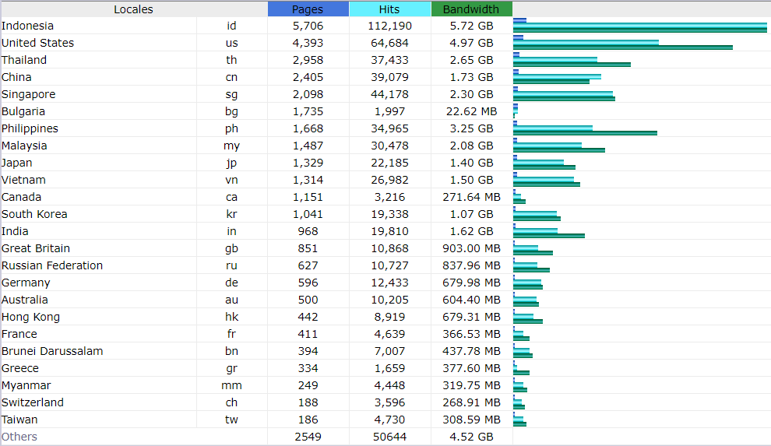
Top Visitor Countries (November 2019)

Slide 5
Thank you

